Slide 1



May 2021
Daniel Gutierrez-Galan
PhD. student, University of Seville (SPAIN)
INRC Workgroup “Spike coding for temporal signals”
Real-time Loihi interface for Neuromorphic Auditory Sensor and ED-Scorbot (RELIAR)
Notes:
Main goals:
To interface any external event-based neuromorphic sensor implemented on FPGA.
To use the Neuromorphic Auditory Sensor (NAS) as input for neuromorphic audio applications in real-time.
To control a robot using spiking PID controllers by using auditory information.

Slide 2
Outline
Project RELIAR
Neuromorphic Auditory Sensor (NAS)
Synthetic Spike Generator
NAS-Kapoho Bay interface
Real neuromorphic application
Questions & Acknowledgment

Slide 3
Project RELIAR
Real-time Loihi interface for Neuromorphic Auditory Sensor and ED-Scorbot (RELIAR)
Main goals:
  To use the Neuromorphic Auditory Sensor (NAS) as input to Kapoho Bay for neuromorphic audio applications in real-time.
  To control a robot using spiking PID controllers by using auditory information.

Slide 4
Outline
Project RELIAR
Neuromorphic Auditory Sensor (NAS)
Synthetic Spike Generator
NAS-Kapoho Bay interface
Real neuromorphic application
Questions & Acknowledgment

Slide 5
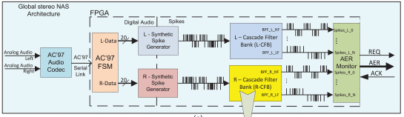

Neuromorphic Auditory Sensor
Neuromorphic Auditory Sensor (NAS) architecture:
“A binaural neuromorphic auditory sensor for FPGA: A spike signal processing approach”, Jimenez-Fernandez et al., 2016, IEE TNNLS
OpenNAS: Open Source Neuromorphic Auditory Sensor HDL code generator for FPGA implementations, Gutierrez-Galan et al., 2021, Neurocomputing
https://github.com/RTC-research-group/OpenNAS

Slide 6
Outline
Project RELIAR
Neuromorphic Auditory Sensor (NAS)
Synthetic Spike Generator
NAS-Kapoho Bay interface
Real neuromorphic application
Questions & Acknowledgment

Slide 7
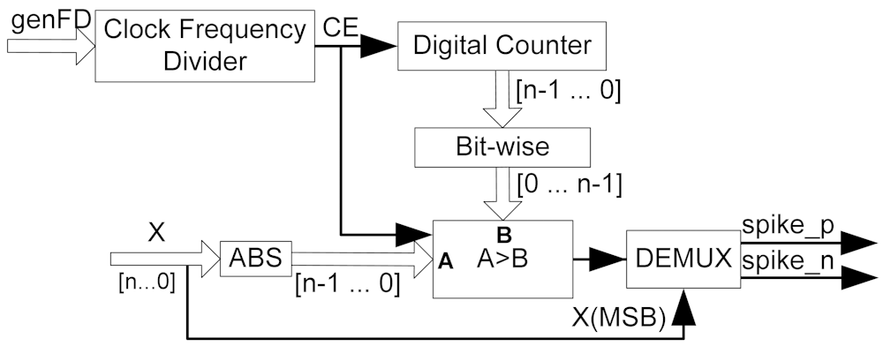
Synthetic Spike Generator
Reverse Bitwise Synthetic Spikes Generator
  Pulse-Frequency Modulation (PFM)
Jiménez-Fernández, Angel, et al. "Building blocks for spikes signals processing." The 2010 International Joint Conference on Neural Networks (IJCNN). IEEE, 1-8.

Slide 8
Synthetic Spike Generator
3-bit reverse bitwise synthetic spikes generator example:
  Frame time =
  8 clock cycles from
  the clock divider.
  Output: highlighted
  in gray.
Input | Slices counter – Frame time
 | 0 | 1 | 2 | 3 | 4 | 5 | 6 | 7
0 | 0 | 4 | 2 | 6 | 1 | 5 | 3 | 7
1 | 0 | 4 | 2 | 6 | 1 | 5 | 3 | 7
2 | 0 | 4 | 2 | 6 | 1 | 5 | 3 | 7
3 | 0 | 4 | 2 | 6 | 1 | 5 | 3 | 7
4 | 0 | 4 | 2 | 6 | 1 | 5 | 3 | 7
5 | 0 | 4 | 2 | 6 | 1 | 5 | 3 | 7
6 | 0 | 4 | 2 | 6 | 1 | 5 | 3 | 7
7 | 0 | 4 | 2 | 6 | 1 | 5 | 3 | 7
Gomez-Rodriguez, Francisco, et al. "Two Hardware Implementations of the Exhaustive Synthetic AER Generation Method ." 8th International Work-Conference on Artificial Neural Networks (IWANN) 2008.
time

Slide 9
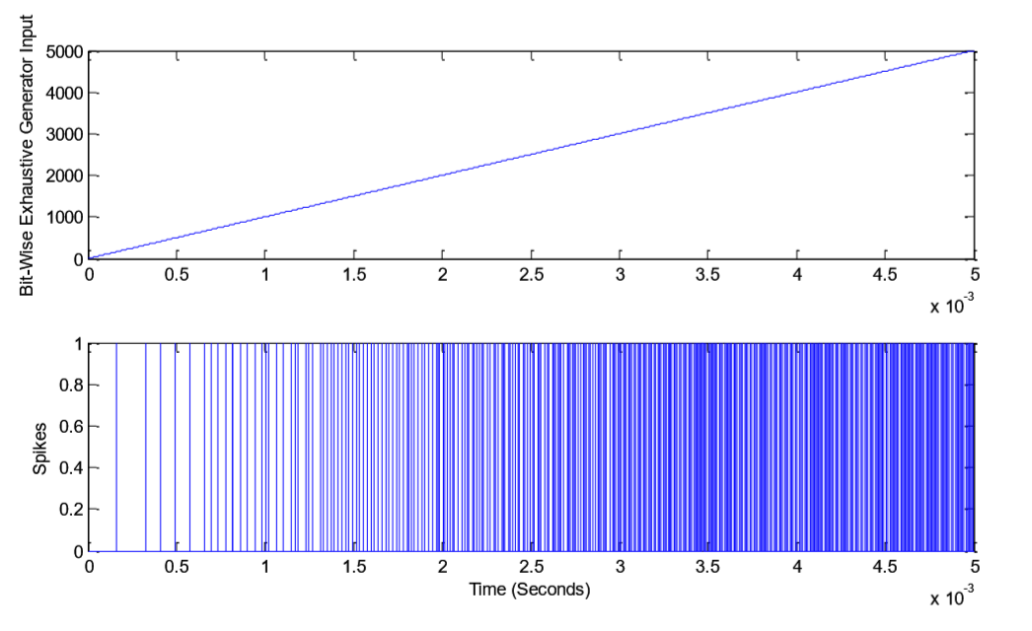
Synthetic Spike Generator
Basic behaviors:
Jiménez-Fernández, Angel, et al. "Building blocks for spikes signals processing." The 2010 International Joint Conference on Neural Networks (IJCNN). IEEE, 1-8.

Slide 10
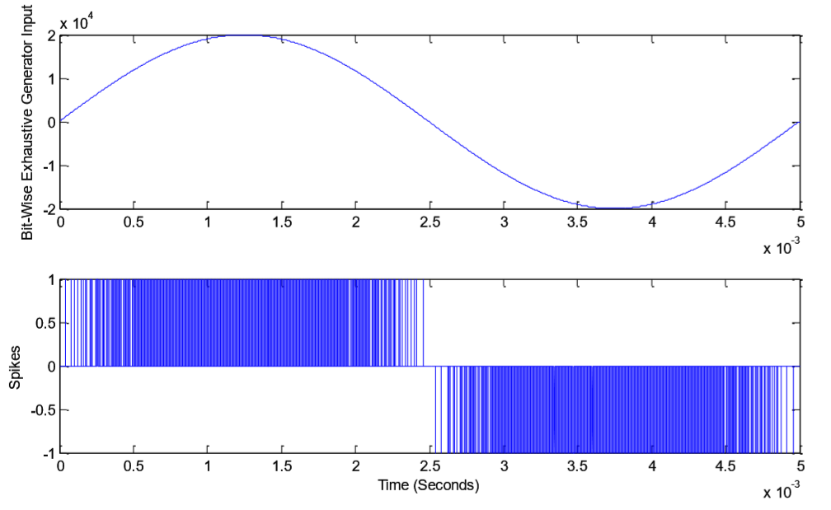
Synthetic Spike Generator
Basic behaviors:
Jiménez-Fernández, Angel, et al. "Building blocks for spikes signals processing." The 2010 International Joint Conference on Neural Networks (IJCNN). IEEE, 1-8.

Slide 11
Outline
Project RELIAR
Neuromorphic Auditory Sensor (NAS)
Synthetic Spike Generator
NAS-Kapoho Bay interface
Real neuromorphic application
Questions & Acknowledgment

Slide 12
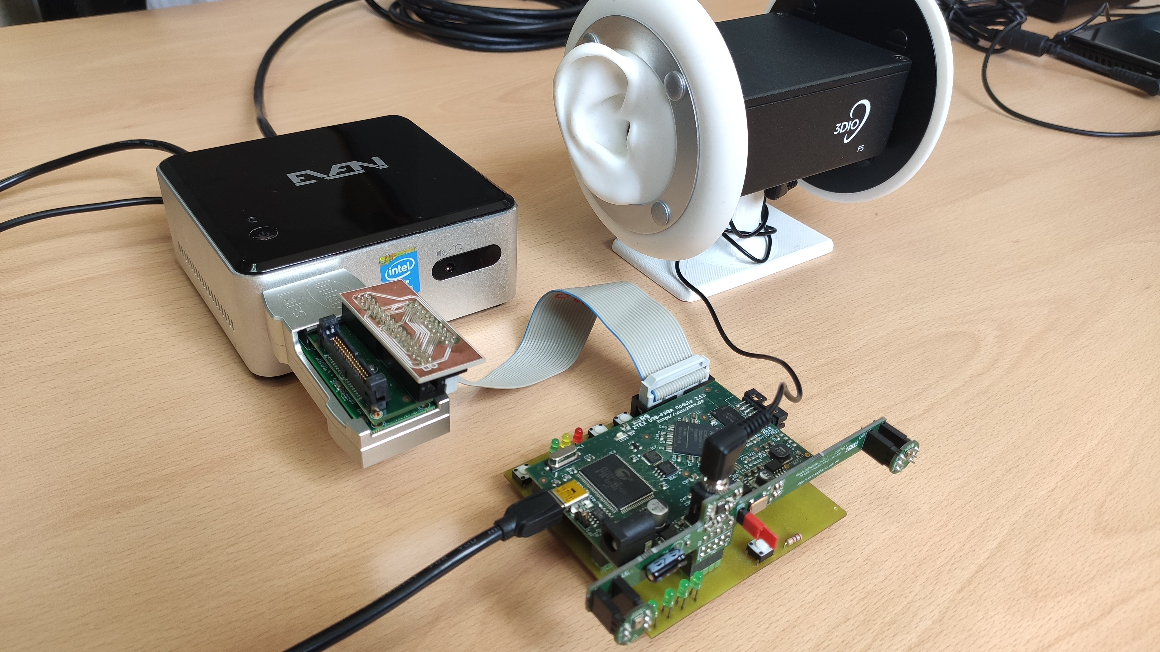
Hardware setup

Slide 13
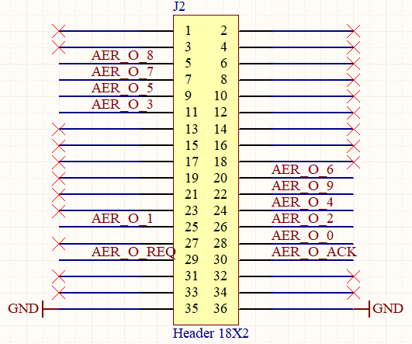
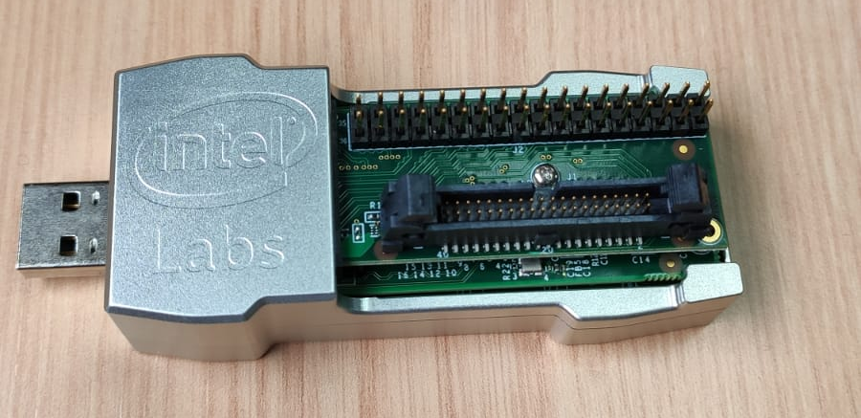
Hardware
36 pins connector (top) for CAVIAR-based connectors.
1
2

Slide 14
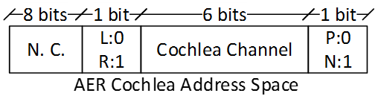
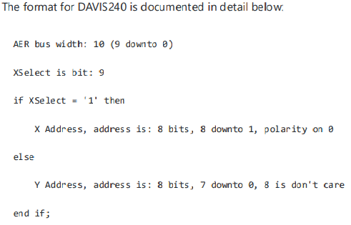
Hardware
Input AER format:
  10 bits for AER data.
  1 bit for AER req.
  1 bit for AER ack.
Both req and ack are low active.

Slide 15
Software
In ..\nxsdk-apps-0.9.8\nxsdk-apps-0.9.8\nxsdk_modules\dvs\src\
  DVS sensor python class: dvs.py
  DVS sensor C code snip: snips\dvs_default.c
In ..\nxsdk-apps-0.9.8\nxsdk-apps-0.9.8\nxsdk_modules\dvs\tutorials\
  DVS sensor live connection: dvs_live.py
  DVS sensor visualizer: snips\default_visualizer.c
Custom main script (application specific)

Slide 16
Hardware
Done:
  VHDL code for sending events from NAS to Kapoho Bay & custom PCB.
To do:
  How could we close the loop between NAS and Kapoho Bay for real-time robotic applications?
  Look for the best spike generator parameters according to Loihi features.

Slide 17
Software
Done:
  Execution of DVS live examples.
  Using NAS’ output events as input of a SNN & real-time visualization (custom visualizer).
To do:
  To adjust NAS’ output firing rate (too high ~30 Mevents/sec).
  Training methods & weights translation from SpiNNaker.

Slide 18
Outline
Project RELIAR
Neuromorphic Auditory Sensor (NAS)
Synthetic Spike Generator
NAS-Kapoho Bay interface
Real neuromorphic application
Questions & Acknowledgment

Slide 19
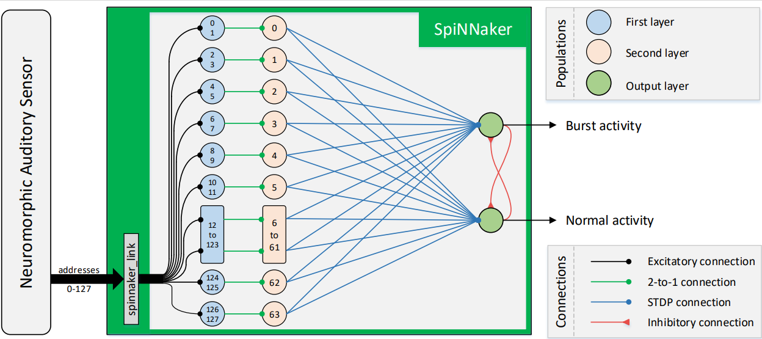
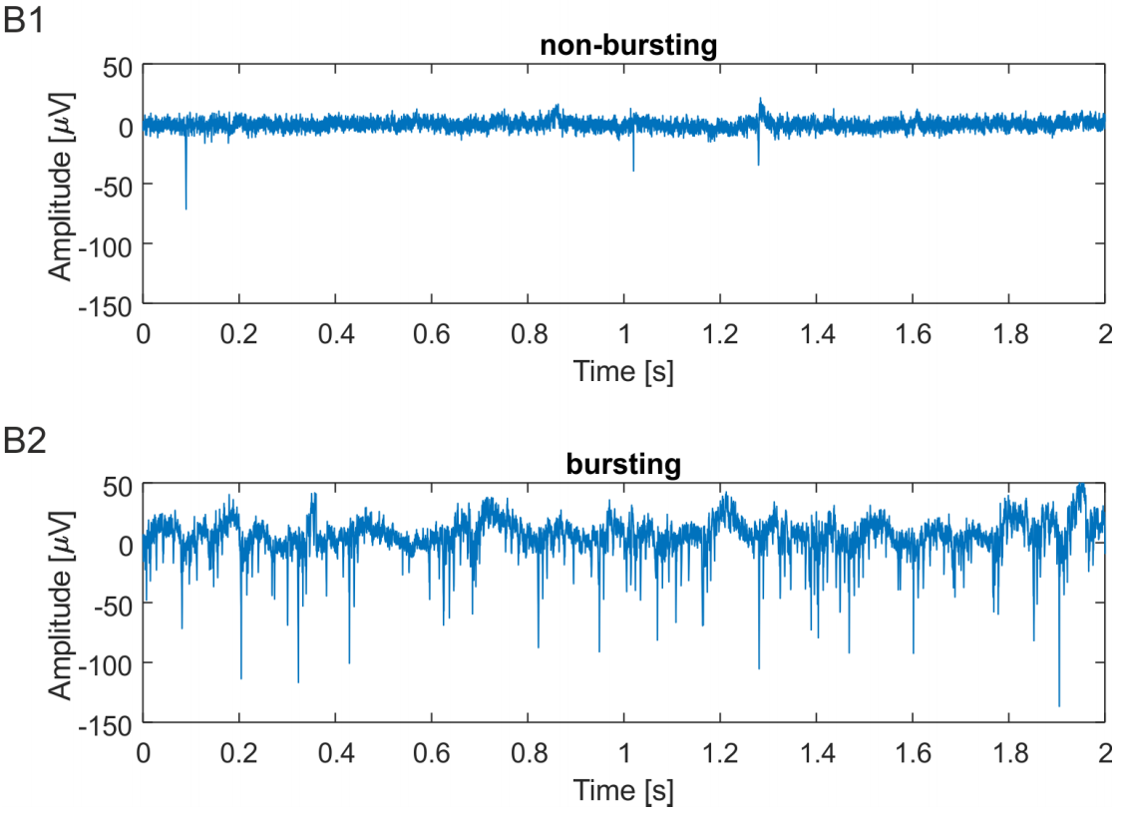
Real neuromorphic application
Real-time detection of bursts in neuronal cultures using a Neuromorphic Auditory Sensor and SNNs:
  Rate coding & STDP.
“Real-time detection of bursts in neuronal cultures using a Neuromorphic Auditory Sensor and Spiking Neural Networks”, Dominguez-Morales et al., 2021, Neurocomputing
Notes:
A novel neuromor-phic approach for real-time burst detection is proposed and tested on acquisitions from in vitro cultures.The system consists of a Neuromorphic Auditory Sensor, which converts the input signal obtained from electrophysiological recordings into spikes and decomposes them into different frequency bands.

Slide 20
Outline
Project RELIAR
Neuromorphic Auditory Sensor (NAS)
Synthetic Spike Generator
NAS-Kapoho Bay interface
Real neuromorphic application
Questions & Acknowledgment

Slide 21

Questions
Thank you very much!
Acknowledgment:
  Yulia Sandamirskaya, Garrick Orchard, and Lyes Khacef, among others.

