Slide 1

RV3.206.Cong: EEG Signal Processing for Closed-Loop Neurofeedback
Zhe Chen, Jim Zhou, Jason Cong
Computer Science Department, UCLA
In Collaboration with Prof. Tad Blair
Psychology Department, UCLA
cong@cs.ucla.edu

Slide 2
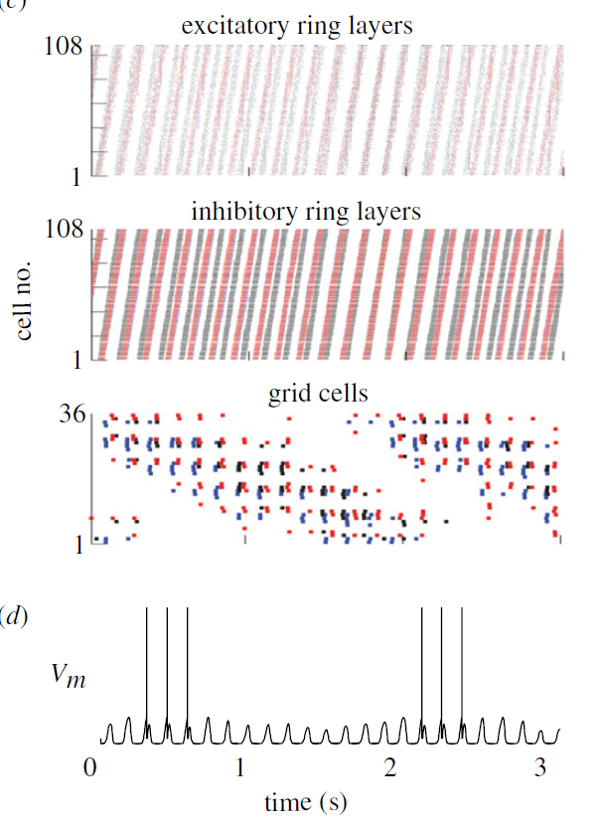

FPGA-Based Neural Microcircuits Simulation
Application: Simulating neural microcircuits for Oscillatory Path Integration
Automatic Design Flow based on High-Level Synthesis
XML-based neural microcircuit descriptions
C code for HLS
RTL design
This Work
CPU Runtime
Biological Time
Performance
39x speedup compared to software benchmarks on commodity CPU.
Energy efficiency
232x energy reduction compared to embedded ARM core.
[1] Wu, D., Blair, H. T. and Cong, J., ICCAD’13.

Slide 3
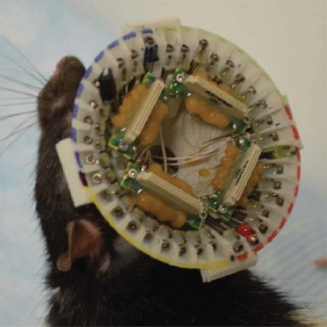
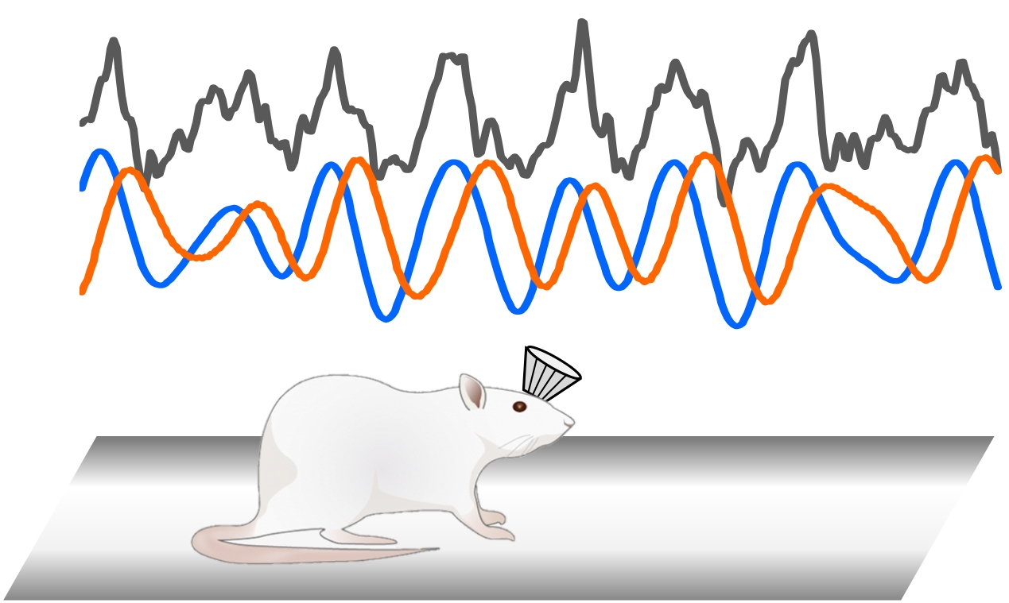
In Vivo EEG Signal Processing for Rats
Conventional Signal Processing based on FIR/IIR Filters
Real-time EEG (LFP, local field potential) signal processing for closed-loop feedback
Undesired Delay:
acausal nature of FIR/IIR filters
y depends on future x
acausal delay
DC Offset Cancelation
Bandpass Filtering (FIR/IIR)
Hilbert Transform (FIR/IIR)
Phase/Envelope Calculation
Feedback Stimulation
Motivation: Reduce acausal delay caused by FIR/IIR filters.

Slide 4
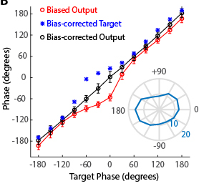
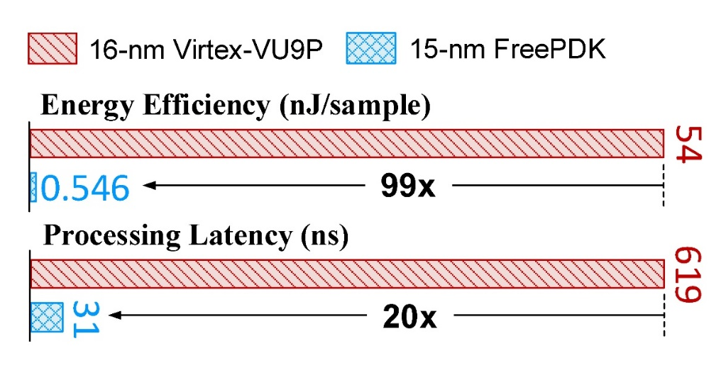
LSTM-Based Causal & Efficient EEG Filtering
< ±3° phase error after calibration
DC Offset Cancelation
Bandpass Filtering (FIR/IIR)
Long Short-Term Memory (LSTM) Inference
Hilbert Transform (FIR/IIR)
Phase/Envelope Calculation
Feedback Stimulation
[2] Chen, Z., Howe, A., Blair, H. T. and Cong, J. “CLINK”, ISLPED’18. Best Paper Award.

