Slide 1
Bio-Inspired Circuits and Systems (BICS) Team – INRC Work Group Keyword Spotting on Loihi using the Time Difference Encoder Lyes Khacef and Elisabetta Chicca

Slide 2
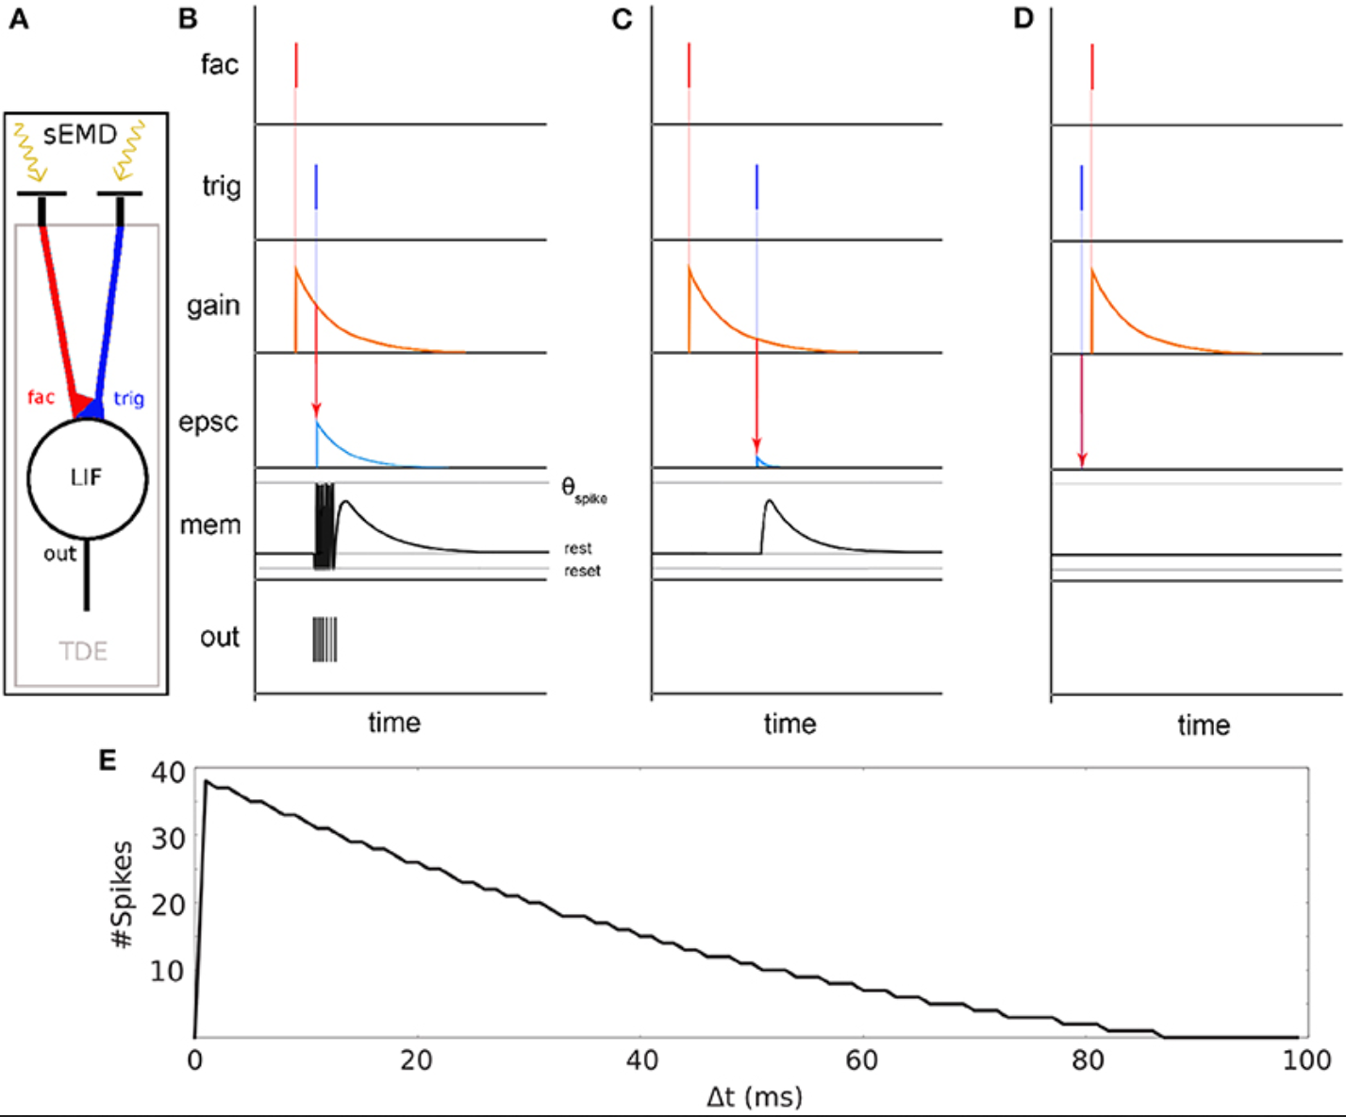
Keyword Spotting on Loihi using the Time Difference Encoder
Motivation: use the TDE as a temporal feature extractor to improve temporal patterns recognition at minimum hardware cost.
[Event-Based Eccentric Motion Detection Exploiting Time Difference Encoding, Giulia D'Angelo et al.]

Slide 3
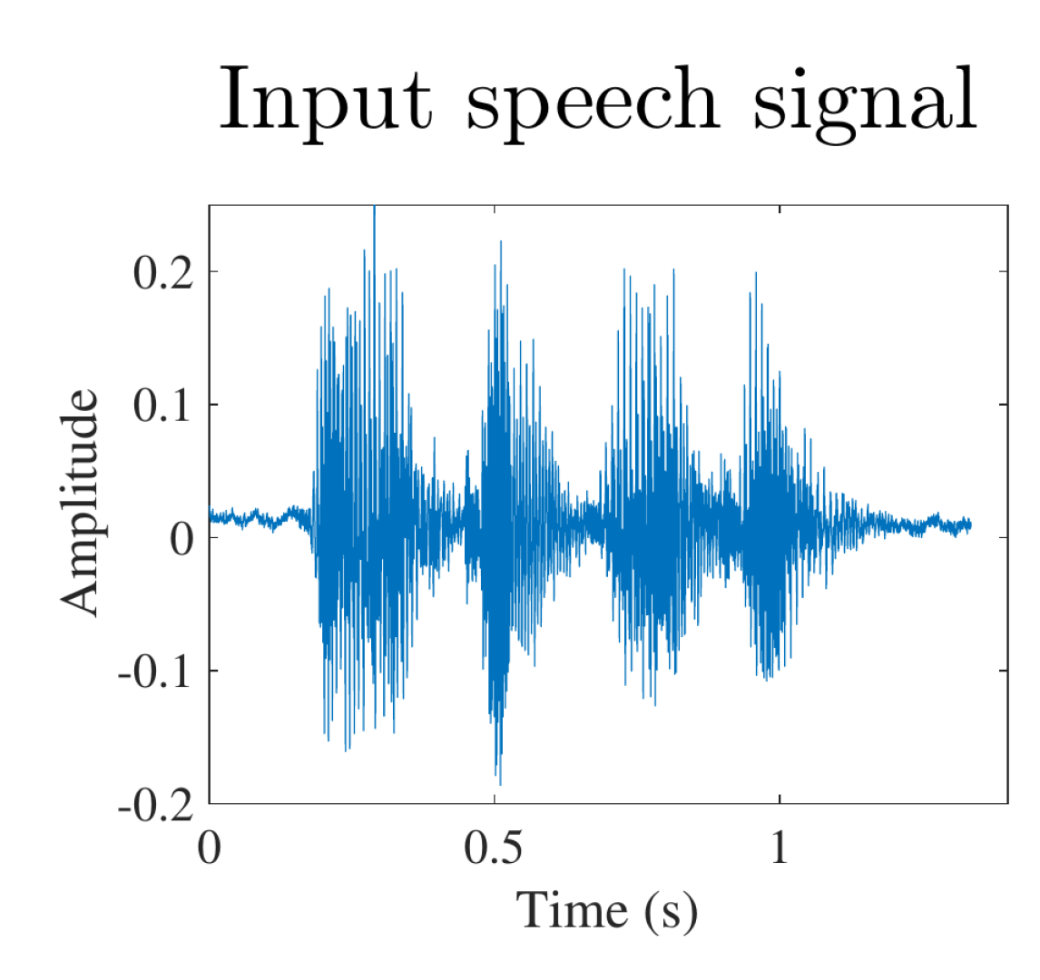
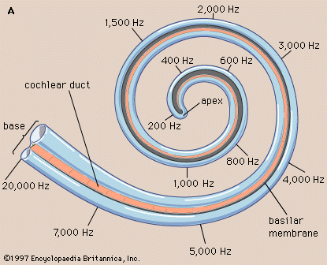
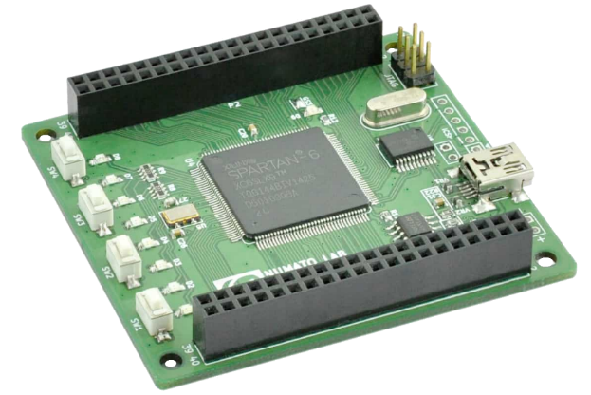
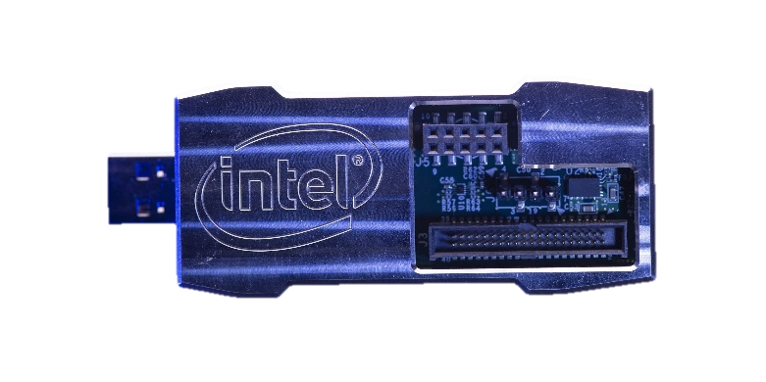
Keyword Spotting on Loihi using the Time Difference Encoder
Information theory metric:
Stimulus Specific Information (SSI)
TDEs layer
Supervised learning with BPTT using SLAYER
Cochlea
Kapoho Bay
[OpenNAS: Open Source Neuromorphic Auditory Sensor HDL code generator for FPGA implementations, D.Gutierrez-Galan et al.]

Slide 4
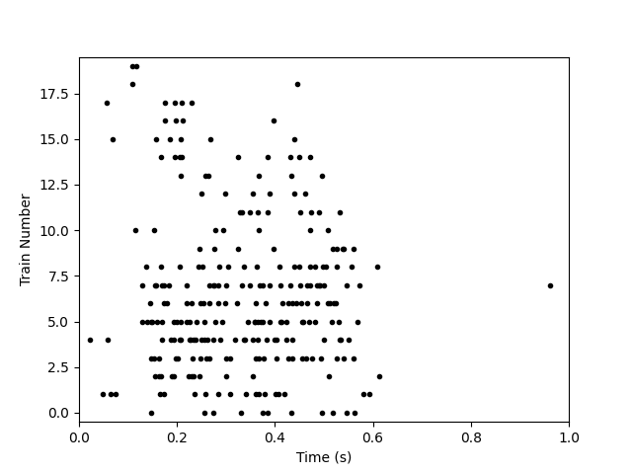
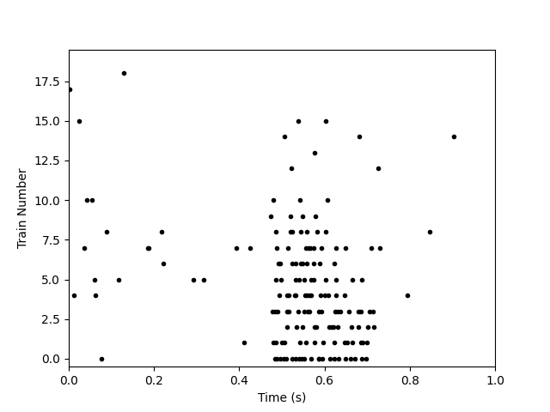
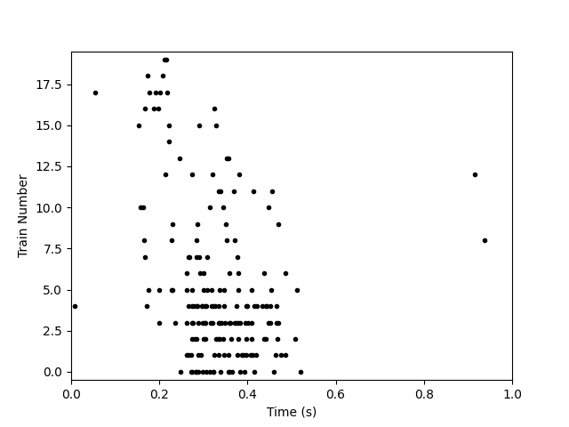
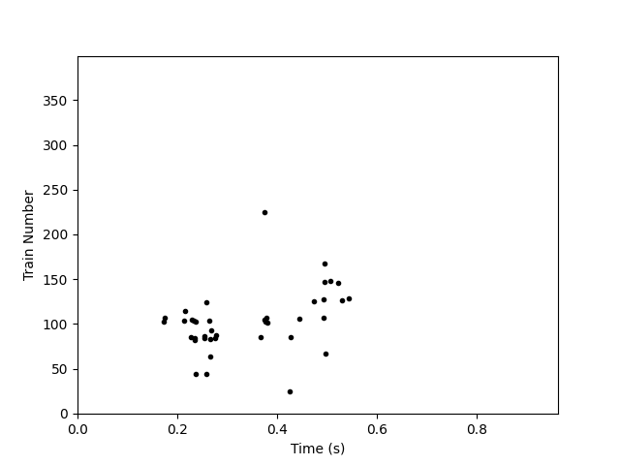
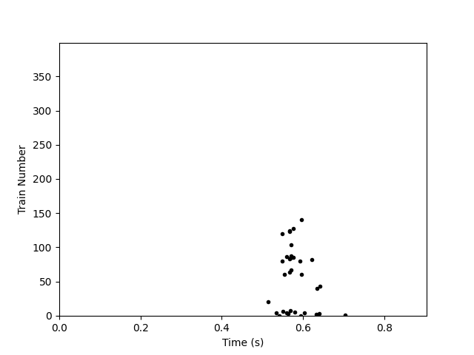
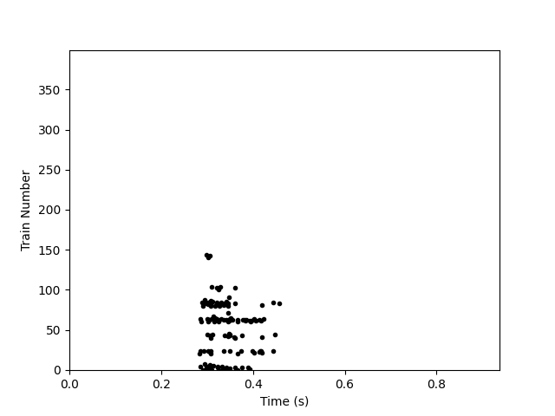
Keyword Spotting on Loihi using the Time Difference Encoder
Digit
Zero
One
Two
Cochlea
64 channels
TDE layer
4096 TDEs

Slide 5
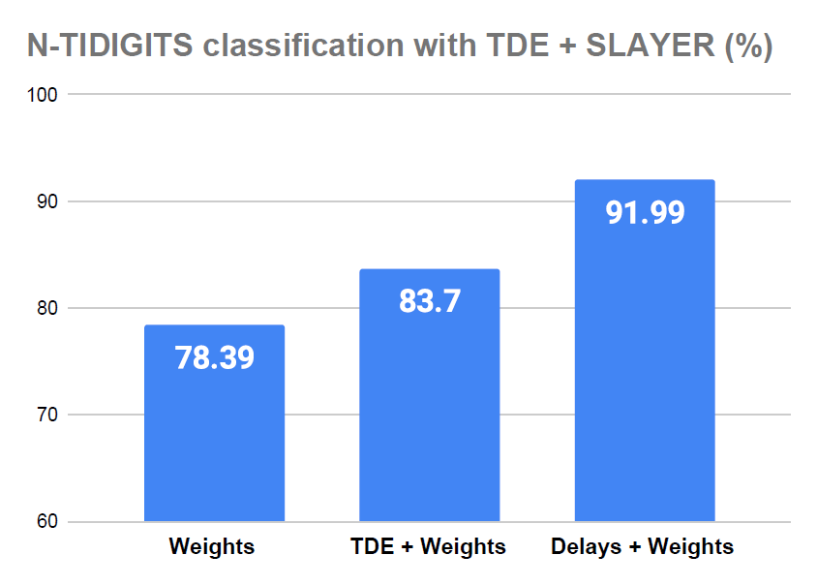
Keyword Spotting on Loihi using the Time Difference Encoder
Preliminary results:
Ongoing work:
Tune the TDE time constants:
1- Use information theory for a first approximation
2- Train the TDE time constants based on [*].
Minimize the number of required TDEs:
Adding a L2 regularization on the first layer weights to increase sparsity -> pruning of 50% of TDEs.
Deploy the TDE + trained net on Loihi:
Connect the KapohoBay to OpenNAS.
Network topology: Input-256-256-242
[*] [Incorporating Learnable Membrane Time Constant to Enhance Learning of Spiking Neural Networks, Wei Fang et al.]

