Slide 1
Sensor encoding
Discussion workgroup
Session 2
INRC Workgroup
2021

Slide 2
Legal Information
Performance varies by use, configuration and other factors. Learn more at www.Intel.com/PerformanceIndex​.
Performance results are based on testing as of dates shown in configurations and may not reflect all publicly available ​updates. See backup for configuration details. No product or component can be absolutely secure.
Your costs and results may vary.
Results have been estimated or simulated.
Intel technologies may require enabled hardware, software or service activation.
Intel does not control or audit third-party data. You should consult other sources to evaluate accuracy.
Intel disclaims all express and implied warranties, including without limitation, the implied warranties of merchantability, fitness for a particular purpose, and non-infringement, as well as any warranty arising from course of performance, course of dealing, or usage in trade.
© Intel Corporation. Intel, the Intel logo, and other Intel marks are trademarks of Intel Corporation or its subsidiaries. Other names and brands may be claimed as the property of others. ​

Slide 3
Agenda
General signal processing and encoding considerations
Fritz Sommer, Yulia Sandamirskaya, Andreas Wild, NCL
20-30min
"Open mic" discussion
10-30 min

Slide 4
Source Coding
Source coding theorem (Shannon 1948):
N i.i.d. random variables, each with entropy H(X) can be compressed into N H(X) bits – but not less
Compression via smooth transform - i.e., remove signal redundancies:
per channel: Histogram equalization
across channels: project data onto decorrelated (PCA) or independent (ICA) coordinates
across time: slow feature analysis
Spike conversion:
Lossy conversion into pulses with discrete (binary) amplitudes, in continuous time (on LOIHI not really) - encoding quality depends on objective (for example, reconstruction error, reconstructed info per spike etc..)
Friedrich.Sommer@intel.com

Slide 5
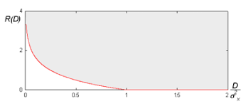
Lossy compression
Rate distortion theory (Shannon 1948):
If signal is Gaussian:
Rate distortion curve (for Gaussian memoryless channel):
Friedrich.Sommer@intel.com

Slide 6
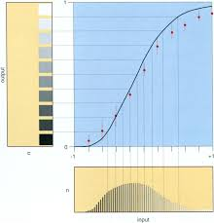
Histogram equalization in the fly visual system
S. Laughlin, Z. Naturforsch., 1981:
Contrast-response function of a class of first-order interneurons (LMC) in the fly's compound eye.
Transfer function = cumulative pdf of stimulus
Friedrich.Sommer@intel.com

Slide 7
Similarity-Preserving Coding
Application might define similarity kernel in continuous data space:
K(x-y) =1 for x =y, dropping smoothly to zero for |x-y| large
Spike patterns/synapses form inner product space
z'w defines similarity between spike pattern z and synaptic weight vector w
Example with spike-timing encoding: KNN paper
Coding function: x -> z(x) with z(x)'z(y) = K(x-y)
Fractional binding
(Hippocampus model: Frady, Kanerva & Sommer, 2018, https://ccneuro.org/2018/proceedings/1263.pdf)
Friedrich.Sommer@intel.com

Slide 8
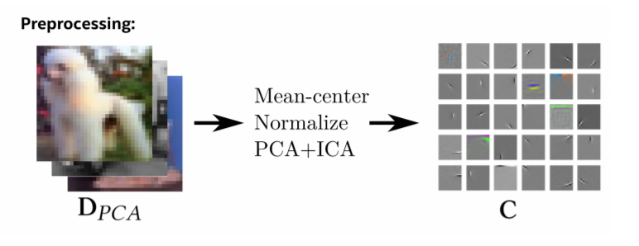
Efficient neuromorphic nearest neighbor search
Sparse and Compressed Basis
Frady, E.P. et al. (2020) Neuromorphic nearest neighbor search using Intel’s Pohoiki Springs. NICE ’20, https://arxiv.org/abs/2004.12691
E.Paxon.Frady@intel.com

Slide 9
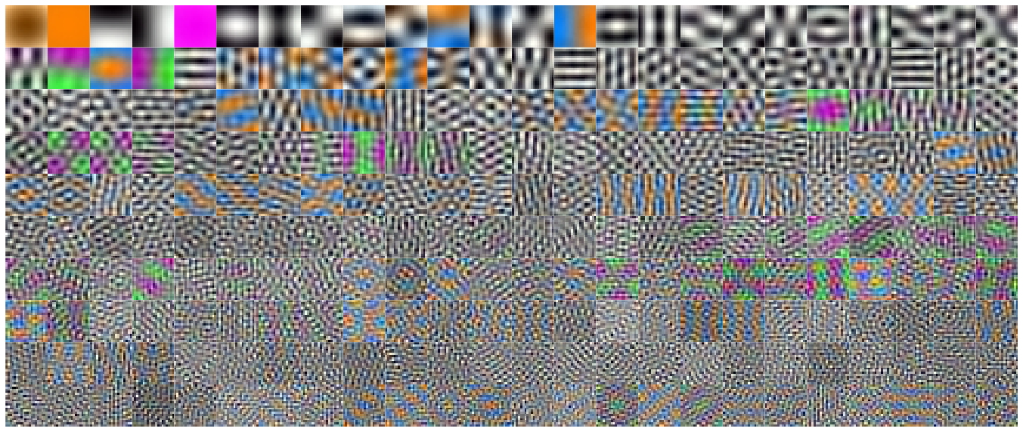
PCA for Natural Color Images
E.Paxon.Frady@intel.com

Slide 10
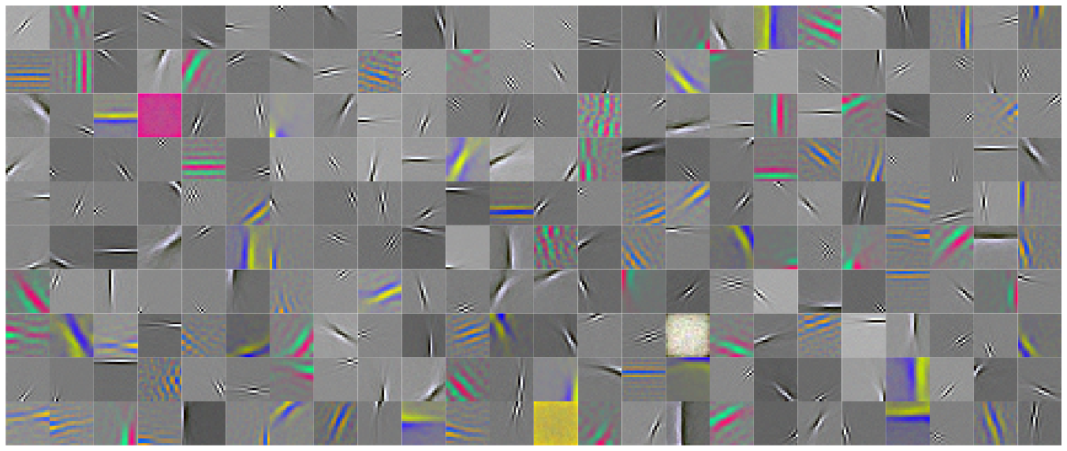
ICA for Natural Color Images
Encoding matrix
E.Paxon.Frady@intel.com

Slide 11
Project input data onto basis functions
ICA
PCA
E.Paxon.Frady@intel.com

Slide 12
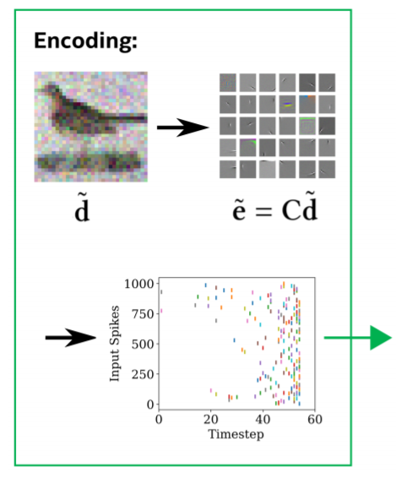
Encode sparse and compressed representation into spikes
Neuromorphic Acceleration
E.Paxon.Frady@intel.com

Slide 13
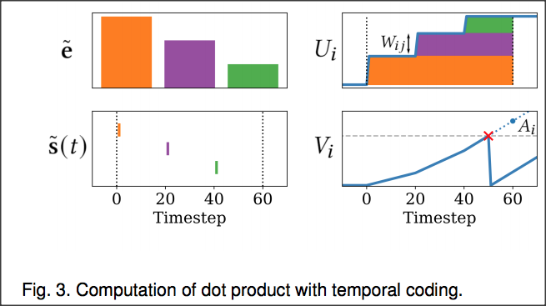
Computing Inner Products in KNN Neuromorphic network
Computing inner product of Spike-latency coded input and synaptic weight vector:
E.Paxon.Frady@intel.com

Slide 14
KNN Tutorial Notebook
E.Paxon.Frady@intel.com

