Slide 1
Sensor encoding
Discussion workgroup
Session 1
Yulia Sandamirskaya
INRC Workgroup
2021

Slide 2
Legal Information
Performance varies by use, configuration and other factors. Learn more at www.Intel.com/PerformanceIndex​.
Performance results are based on testing as of dates shown in configurations and may not reflect all publicly available ​updates. See backup for configuration details. No product or component can be absolutely secure.
Your costs and results may vary.
Results have been estimated or simulated.
Intel technologies may require enabled hardware, software or service activation.
Intel does not control or audit third-party data. You should consult other sources to evaluate accuracy.
Intel disclaims all express and implied warranties, including without limitation, the implied warranties of merchantability, fitness for a particular purpose, and non-infringement, as well as any warranty arising from course of performance, course of dealing, or usage in trade.
© Intel Corporation. Intel, the Intel logo, and other Intel marks are trademarks of Intel Corporation or its subsidiaries. Other names and brands may be claimed as the property of others. ​

Slide 3
Agenda
Fundamentals of sensor encoding in neuromorphic hardware
NCL team (20-30min):
Mike Davies
Yulia Sandamirskaya
Input from other participants
3-5 min per statement
"Open mic" discussion
10 min

Slide 4
Setting the scene
Know your input signal:
Dimensionality
Temporal and value resolution
Temporal dynamics
Dynamic range
Know your neuromorphic hardware
Temporal resolution
Energy per spike
Energy per time step per neuron
Cost of fan-out
Values resolution
Know your task
Recognition (classification, discrimination)
Detection
Does space, time, or both matter
What are the scales involved and resolution required
Constraints, baselines: Latency? Accuracy? Throughput?
Offline or online processing
Design the sensory pipeline
Sensor
Preprocessing
SNN on chip

Slide 5
A First Principles Perspective on Neuromorphic Coding Efficiency
NeuronOps cost energy
M. Davies
F average fanout per axon
$$e_{nop}=e_{dyn}+P_{static}⋅Δt$$
M axons
$$P_{static}$$
N neurons
$$e_{dyn}$$
0
0
1
0
0
1
0
0
0
0
0
0
1
1
0
0
1
0
0
0
0
0
1
0
0
0
0
0
0
1
$S⋅F$ total SynOps
$$Δt$$
$$e_{sop}$$
$$e_{sop}$$
M axons
SynOp
$T⋅N$ total NeuronOps
T timesteps per symbol, S total spikes
$$Δt$$
Information content (bits) per T timesteps
NeuronOp
$$I=\log_{2}\left(\begin{matrix}MT \\ S\end{matrix}\right)≈MT\left(λ\log_{2}{\frac{1}{λ}+\left(1−λ\right)\log_{2}\left(\frac{1}{1−λ}\right) }\right)$$
SynOps and NeuronOps are both fundamental to the energy and runtime characteristics of a workload
$$E=S⋅F⋅e_{sop}+T⋅N⋅e_{nop}$$
Where $λ=\frac{S}{MT}$ (spike activity rate over T timesteps)

Slide 6
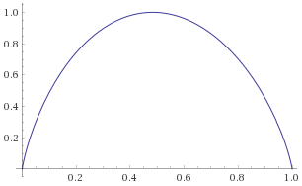
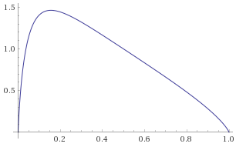
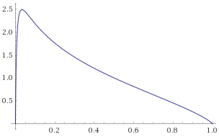
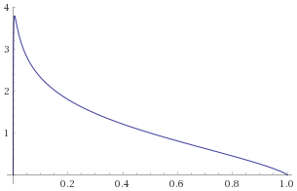
Example application: Maximizing information per Joule (Information Theoretic Perspective)
Sparse communication in time maximizes energy efficiency
Efficiency of communicating the symbol to N neurons (bits per Joule):
$λ$ = Spike activity over the channel (~ probability of transmitting a spike)
$$C=\frac{M⋅F}{N}⋅\frac{e_{sop}}{e_{nop}}$$
$$ε=\frac{I}{E} ∝ \frac{λ\log_{2}{\frac{1}{λ}}+\left(1−λ\right)\log_{2}{\frac{1}{1−λ}}}{λ⋅C+1}$$
= maximal synop energy versus total neuron energy per timestep
Note: for Loihi, $\frac{e_{sop}}{e_{nop}}$ can range between ~0.4 (us/timestep) to
~0.03 (ms/timestep)
Relative efficiency vs $λ$=0.5 as cost of communication increases
15% activity
5% activity
1% activity
50% activity
C = 0.1
C = 10
C = 100
C = 1000

Slide 7
For robotics…
A real-time setting, so Interested in power, not energy per computation:
$$P=\frac{E}{T⋅Δt}=N⋅P_{static}+\frac{N⋅e_{dyn}}{Δt}+α⋅F⋅e_{sop}$$
$α=\frac{S}{T⋅Δt}$ = aggregate spike rate (spikes/s)
Want $α$ as low as possible (mainly on interface)
Want $Δt$ as high as possible (time resolution is expensive)
High energy, bandwidth-constrained interface
Sensor
Preprocessing
Neuromorphic chip
Goal: Transform input signal to sparsest representation

Slide 8
Encoding of measured values with SNs
1. Single-valued data representation
ISI coding
First spike / phase / time coding
Value =
Input current
Periodicity in sensing (sampling)
What happens in the next layer?
Rate-coding
To keep in mind:
Value discretization, resolution, and range
log scaling for large dynamic range;
hierarchical representations;
rescaling the axis of the data depending on the "data-density"/statistics, based on entropy-max function
need to invert this function later on
Neurons I/O response (input current -> rate) is non-linear (sigmoid)
with IF without refractory period: close to linear until it saturates (refractory, or time-discretization)
Positive and negative values -> two input neurons / paths, or rescaling if no qualitative difference
Examples:
PID controller
Spiking D-RL network
Path integration / SLAM

Slide 9
Sensor data as input to an SNN
1b. Single-valued data representation:
Fourier space (auditory, vibrations, oscillations, frequency content determines the signal)
Temporal convolutions / correlations
- bank of analog resonators ("cochlea"), Hopf transform
- spike rate -> "energy" in a frequency channel (bank of neurons)
To keep in mind:
- non-linear effects? (dependence on the amplitude)

Slide 10
Sensor data as input to an SNN
2. Population coding
Why / When is it useful?
To increase bandwidth / dynamic range
Dynamics in the encoded space matters
“Kalman filtering”, DNFs, attractor dynamics
Noise filtering; working memory; “collective state”; robust representation
Estimation / Detection / Categorization are of interest, rather than discrimination
Facilitates learning of (non-linear) mappings between variables
How to apply population coding:
Define "dimension(s)" (velocity, position, force)
Determined by the task
Learning: SOM, supervised or unsupervised learning
Introduce receptive fields (with gain and offset) or tuning curves for each neuron in the population
Sampling of the input space
Receptive fields can also be learned
Inject current as input, scaled with the tuning curve
Note the activation (rate, timing) represents the “certainty” of the sensed value now

Slide 11
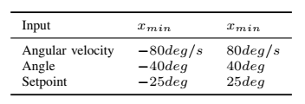
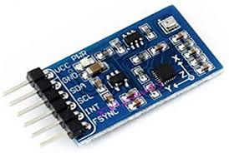
Representing values in an SNN on chip
Value ranges on the drone
idx
Sparse space code
0
1
IMU
2
Identity of an active neuron represents the value
3
4
…
Each spike carries the value
…
Population code could account for uncertainty
63

Slide 12
Sensor data as input to an SNN
3. When we deal with vision or other high-dimensional input
Deep NN, CNNs
Shallow sparse representation
Projection into a space where discrimination is facilitated
Making info propagating down-stream sparse
(encoding based on a “training set” to pre-processing dense input into a sparse and compressed input)
Typically high-dimensional input with rich spatial structure (e.g., vision)
Approaches:
(DNN/CNN: “dense” features) -> take an NPU, use DNN->SNN conversion
LCA: sparse features
Our kNN example: Efficient spatial-temporal encoding

